Slide 1

CLOSE READING GUIDE
NINH
AsAm Studies
UCSB

Slide 2
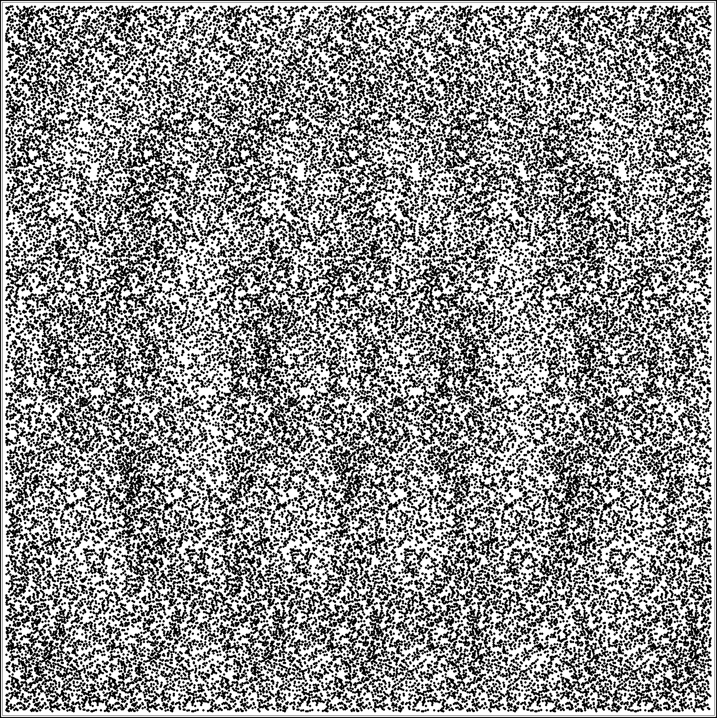
Welcome to close reading! Where we solve for literary meaning--and that always takes digging.
What you gather from a passage on a quick read is just its surface meaning. This is basic reading comprehension, or what the passage “says.”
For the purposes of a close reading, surface meaning is informational static.
You are learning to see the images/patterns behind it.

Slide 3
in other words...
Literary meaning is a threshold concept:
Discipline-specific, threshold concepts are “initially troublesome.” They can be “‘counter-intuitive, alien … or incoherent’ because they challenge existing beliefs, past practices or inert knowledge, or can be conceptually difficult. [They] challenge the learner to reflect on tacit knowledge of which she is ‘only peripherally aware or entirely unconscious.’”
Close readings ask you to locate and explain literary meaning--so if you’ve not yet crossed that threshold, it is normal for this to be hard.

Slide 4
Once you know how to close-read...
You move beyond summarizing or “discussing” a passage. You interrogate it, in pursuit of a research question—and make a case for your thesis/interpretation.
You’ll be able to see--and fully persuade your reader of--patterns of ideas that amplify or can even overturn the facile impressions of a first/surface reading.
That’s close reading at its best--and most fun!
Those embedded, encoded literary meanings call for proving—they’re both worth the effort and don’t fly without it.

Slide 5
In form, think of each close reading as a paragraph within your paper: It sets forth a single claim, and then proves that claim by systematically deriving it from textual evidence.
Aim for the focus and logical rigor of a mathematical proof.
Each close reading (i.e., each paragraph), then, is structured like a mini-argument:
Thesis
Evidence
Conclusion
These slides will introduce you to the mechanics of close reading using a “crime detection” analogy.
Awkward? Maybe. But if it works, I’ll take it.

Slide 6
Forensic procedure
1) Secure the scene: What’s the surface meaning?
Start by getting clarity on that--because it serves as a good point of contrast. After this, you’re going to be looking for things that complicate or contradict it.
2) What kind of crime is this? Use key concepts from the prompt to direct your search.
Okay, IRL you don’t get a prompt with conceptual starting points. But this a learning exercise, so you get shortcuts: a pre-fab research question.

Slide 7
Work the scene:
3) What does this passage mean or do?
Scan the passage (process the scene) for language related to key concepts from the prompt, to begin developing your working thesis. You need not answer all the questions posed by the prompt. For now, venture a rough guess as to what tricks the passage may be doing with that concept.
The goal is eventually to identify a single, salient ‘message’ or behavior exhibited by the passage indirectly—embedded in its patterns rather than stated on its face.

Slide 8
What’s a clue?
4) Which bits of language might be evidence?
Not everything in the passage is conceptually relevant or interesting. Which details are useful clues?
Check the likely suspects on the next few slides for leads on what choices the writer made, and how these choices reinforce its meaning.
Also consider what alternatives you don’t see the writer using. Realizing what she chose not to do can advance your understanding of what she did.
Remember that your objective is ultimately to connect the writer’s specific choices to their implications for meaning. (e.g., She did X to convey ABC message.) This is the pay dirt.

Slide 9
Figurative language
But beware of essentializing assumptions!
“Water” does not have a single, universal meaning, across all people and contexts; “green” does not mean the same thing in all books. Make sure you are reading for case-specific, local patterns of signification—otherwise you’re not close-reading.
Are images, similes, or metaphors are used? What are their effects?
Figurative language works by applying a widely- established logic to clarify/express that of a more idiosyncratic or obscure situation. Compare the differences in association between two simple predator-prey metaphors: insect in spider’s web vs. lamb in lion’s den. What connotations of calculation or innocence, and what associations with the ominous or the religious, might one of these choices carry that the other doesn’t? A choice of metaphor is rife with implications, whether or not the speaker knows of them all.

Slide 10
Diction & Syntax
Consider also the ways in which phrases, clauses, or sentences are put together (syntax). Look for distinctive word order, grammar, punctuation, sentence length or structure, such as a predominance of nouns or verbs or other parts of speech.
Look for the idiosyncratic.
Consider deliberately consistent or unusual-seeming phrasing or word choice (diction). Do repetition, formal or informal language, or other styles of speech stand out to you? What meanings does the particular wording create that synonyms or other approximations would have altered or precluded?
How might these reinforce or manipulate the pattern/message you’ve identified?

Slide 11
Sequence
A writer often places things in a specific order or proximity because she believes or wants to lead us through a certain sequence of connections. So the arrangement of thoughts and their juxtaposition are often meaningful, especially if the pattern occurs more than once.
What order do events, dialogue, terms, or ideas take in the flow of the passage? Is the passage directing you as a reader to make certain conceptual associations, or to be persuaded by a certain logic, modeled by the order in which it moves through its ideas?

Slide 12

What’s the nature of the crime?
3) Decide on your pattern.
You’ve gathered a lot of information by this point; what you include in your close reading depends on what you can synthesize into a pattern: For your thesis statement, which techniques→which meanings?
But :
Take into account counterevidence before you commit to a claim.
The connection between the “technique” and “meaning” you choose should be logical—not arbitrary. (see next slide)

Slide 13
Thesis statements:
Logical vs. Arbitrary
NO PATTERN: The author uses diction and sequence to show how much the character has changed.
PATTERN: The author moves from active to passive language, to show the character’s loss of power.
ARBITRARY: The recurring use of “eyes” shows the character’s resistance.
LOGICALLY CONNECTED: The use of figurative “eyes” without sight suggests the character’s resistance to seeing what has happened.

Slide 14
PRO TIP for thesis statements
Choose your words…
• precisely—is this the best term for the job?
&
• conservatively—enlist as few terms as possible (even synonyms can mean something too different!)
Consider each term a variable, the value of which you will need to define.
ASSIGN YOURSELF THE MINIMUM NUMBER OF VARIABLES!

Slide 15
How will you argue this case?
4) identify all units of ideas the claim comprises
No viable interpretive claim can be comprised of just a single idea. It may be constructed by combining several key concepts; it may hinge on a contrast, an analogy, or other logical relationship. Identify all the active components in your thesis & determine how they are related. Your close reading must demonstrate not only each idea systematically, but that they connect to each other in the manner described by the thesis.
For example:
1. Show prevalence of “eyes”
2. Show that they are consistently eyes in wood, a kind of marble, or other objects without sight
3. Show that they are associated with avoidance or deflection.

Slide 16
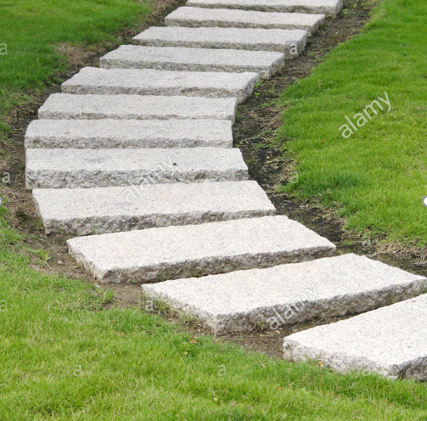
Perry Mason time:
5) making your argument
Organize CONCEPTUALLY. Create a logical pathway for your reader to follow, as methodical as a geometric proof, to move your reader deliberately toward your conclusion.
Avoid organizing your argument chronologically!
Unless your argument is explicitly about the chronological evolution of a pattern, there’s no reason to proceed through the passage from start to finish. Pave your “logical pathway” with connected ideas, not sequential details.

Slide 17

Quotes--and how to use them
Cite specifically, but succinctly.
Include only the part of the sentence you really need.
No block quotes!
Quote only when/because you intend to explain how those exact words are key to meaning.
Give EVIDENCE, not examples.
Spell out how your evidence matches up with your concepts, forms your pattern, and contributes to your overall interpretation.
REMEMBER: How do you give evidence of a shirt?

Slide 18

Close-reading DON’Ts
GENERALIZATION: If it calls for evidence not in the passage, don’t go there.
SPECULATION: If you’re guessing (“maybe,” “perhaps”), you’re not proving.
EVALUATION: Do not ‘review’ the author’s choices with judgments of ability (e.g., “cunningly” or “skillfully”).
REMEMBER:
this is not a Rorschach test!
CR asks not what the passage “reminds you of,” but what it hides, for you to find.

Slide 19

Enjoy!

