Slide 1
SKETCH IT OUT.
Using Storyboards to “Mock Up” Your Podcast.

Slide 2
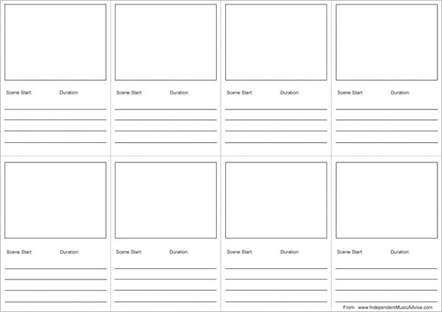
What is a storyboard?
A storyboard is a visual organizer that gives you a “bird’s eye view” of your podcast.
The storyboard can take a lot of different shapes, but it might look like a “flow chart” with boxes representing each “scene.”

Slide 3
Why storyboard?
Any large project (a book, a movie, a website, an app, etc.) can benefit from a storyboard.
The storyboard helps you figure out:
How much time you have and how you should use it;
How “scenes” might fit together;
What you’ll need to collect (recordings, sounds, music, transitions);
The storyboard is modular. It helps you anticipate the podcast “flow” and reorganize and/or revise your vision early on.
The storyboard gives you direction to move forward.
You may use it to build a script, to write interview questions or discussion prompts, etc.

Slide 4
How to Storyboard
There is not a single correct way to storyboard.
Still, your storyboard should include:
Detailed and specific descriptions of “scenes”;
Accounts of discussions/voiceover narrations (topics/major points or ideas at least--you don’t need scripts just yet);
Placeholders/ideas for music, sound effects, and other audio effects;
Timestamps (How long will each “scene” last?)

Slide 5
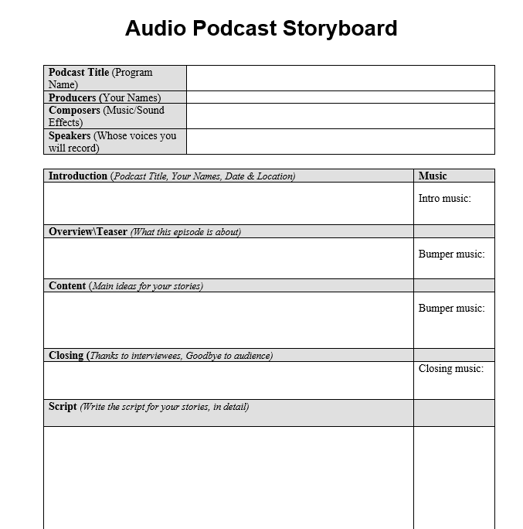
An example
Important: Your podcast may not fit this “flow”; customize your storyboard to plan your podcast as needed.

Slide 6
Try it!
Using the models we considered above, or a format that makes more sense to you and your group, craft a storyboard for your own podcast. Be sure to include:
Descriptions (as detailed as possible) of your various “scenes” and conversations, including who will speak when and about what;
Timestamps (at least rough estimates) that will show how you will break up your podcast and how long you expect each scene to run;
Audio components: Where will you have music? Transitional cues? Sound effects?

