Slide 1
'Straight outta Compton'
N.W.A's Influential Album
Hamed afastu

Slide 2


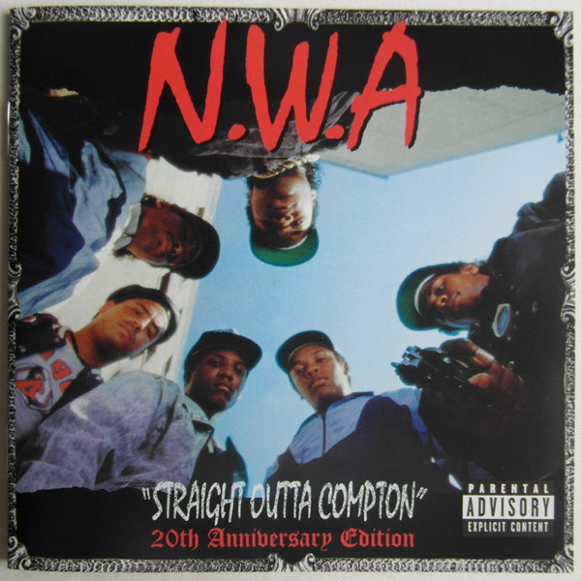
The decades impacted
You can easily say this album impacted the following decades:
1980's
1990's
2000's
2010's

Slide 3
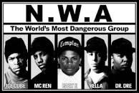
WHo is the N.W.A.
The N.W.A. was an American Hip Hop group based from Compton, California. N.W.A. stands for "N****z Wit Attitudes" and were an active group from 1987 to 1991. There small time together still had a massive impact on many Americans to this day. Some may say they are one of the greatest and most influential Hip-Hop groups ever. They popularized the 'gangsta rap' genre. Ice Cube (O'Shea Jackson), Dr. Dre (Andre Young), Eazy-E (Eric Wright), DJ Yella (Antoine Carraby), and MC Ren (Lorenzo Jerald Patterson), were the original members. Their music was banned on radio stations due to "glorification of drugs and crime". Their songs talked about experiences with racism and experiences with brutal policing.

Slide 4
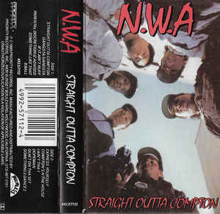
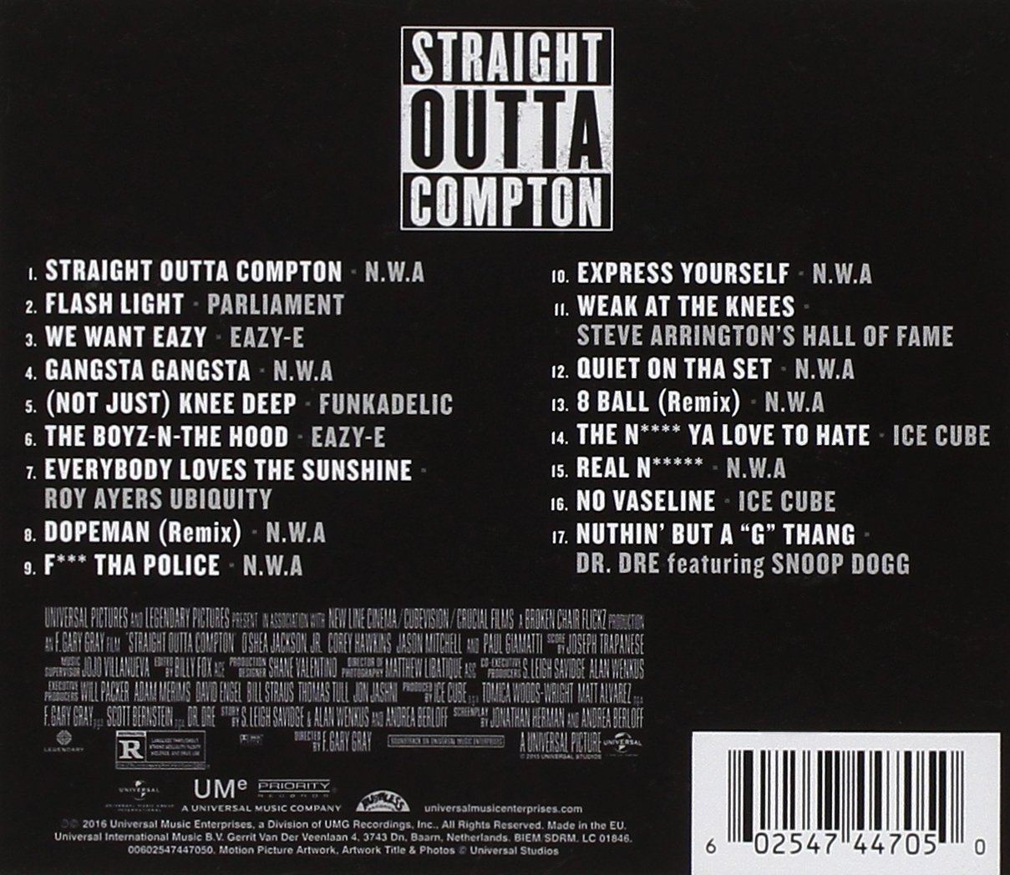
Straight outta compton
The album 'Straight Outta Compton' was released on August 8, 1988. It was the debut album for the group N.W.A. It was considered a pioneer for 'gangsta rap' due to the graphic profanity. 'Straight Outta Compton' peaked at #37 on billboard and #9 on Billboard Top Soul LPs. Also sold over 3 million copies to this date.

Slide 5
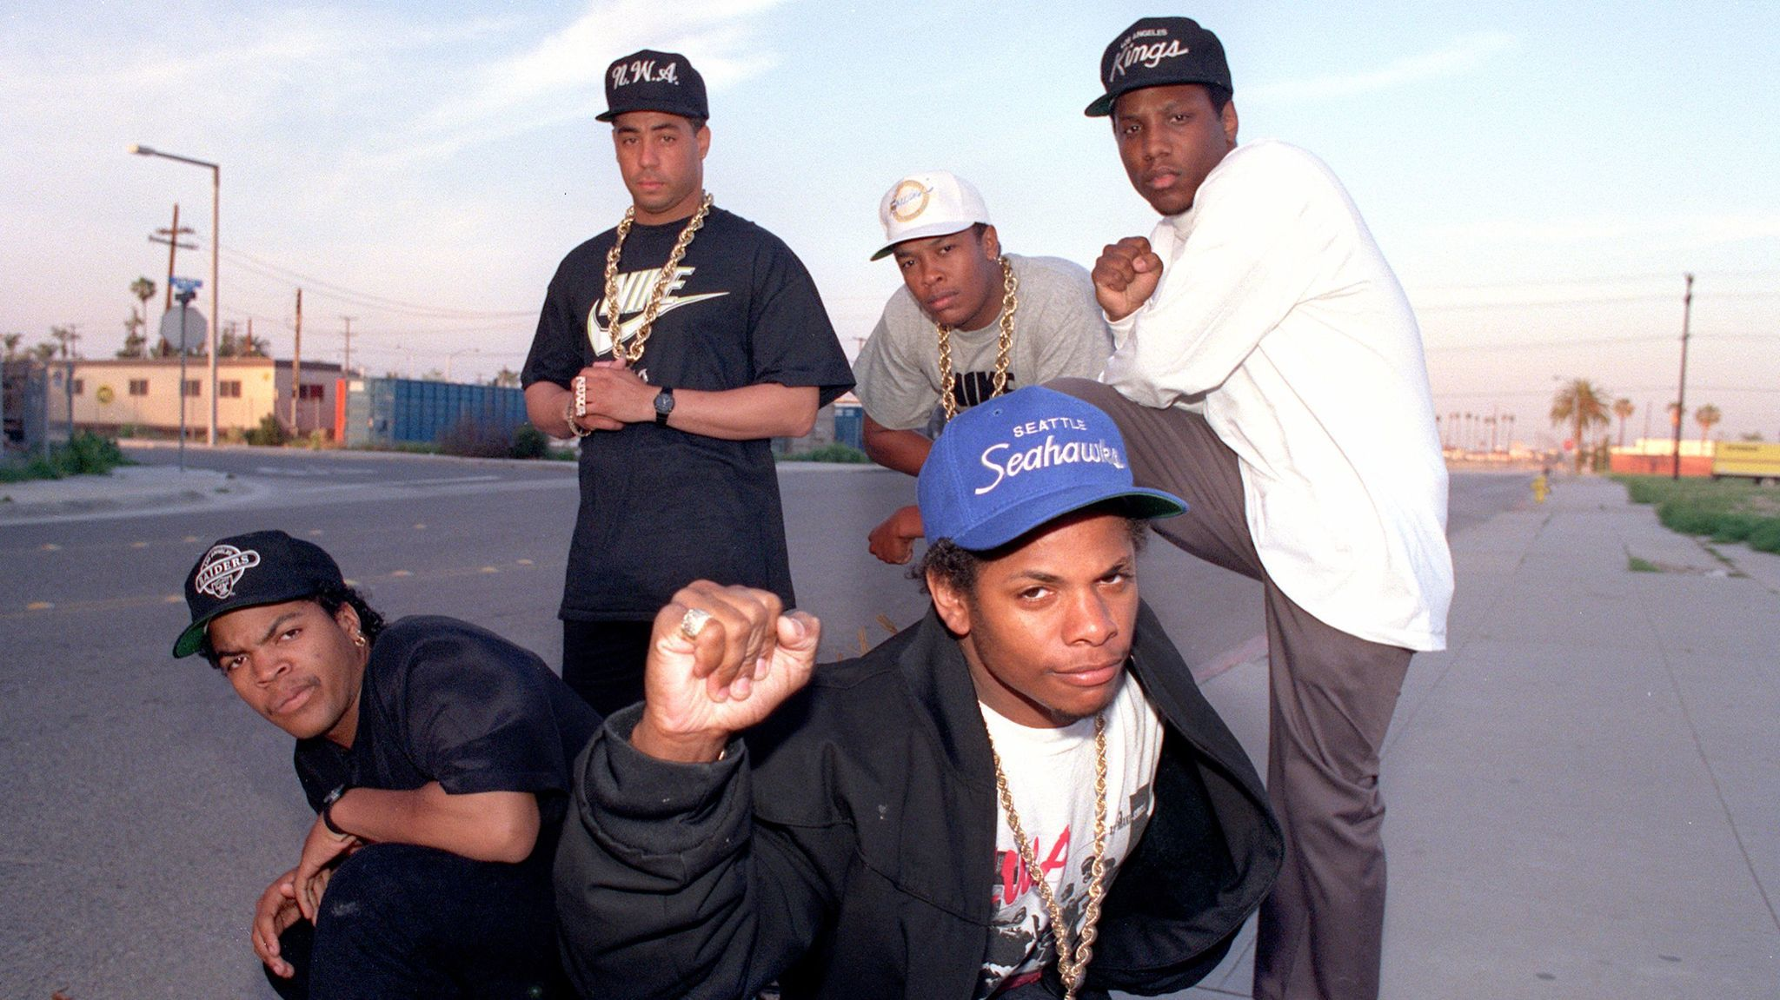
Impact in different decades
The impact 'Straight Outta Compton' had on the 80s was a "seismic shift" in the hip-hop world according to the Los Angeles Times. At the time Compton, California was a center of drugs, gangs, poverty and unemployment. The Hip Hop groups music was based on the conditions and how they were treated in Compton. Right as the album came out it attracted hate from big platforms such as MTV, critcs and Radio stations. People didn’t see past the vulgar language and politicians targeted them as negative influences. The groups emergence in the late 80's provided a bang to the rap industry and were a group similar to 'Public Enemy' who also made pro-Black music. The song 'F**k tha Police' is still used till this day after the spike in police related shootings of African Americans. This song is used in protests and neighborhoods that aren't so friendly to cops.

Slide 6
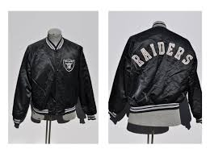
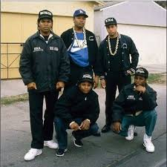
CLothing INfluence
The movie 'Straight Outta Compton' had a scene where one of the members, DJ Yella, is reprimanded by Eazy-E for wearing a yellow vest. NWA mad sure they wore their cities football colors. The LA Raiders team colors are black, siver and white. NWA made sure to wear their teams colors to show the anger of young black males against the negative things going on in their communities. The N.W.A. were also known for their bomber jackets which started a fashion trend at the time. They came out with their own bomber jackets as merchandise. The bomber jacket was brought back in the 2010's as a fashion trend again.

Slide 7
Artists inspired by the N.W.A.
DJ Quik lifted a sample from "Compton's in the House (Remix)" for his song "Born and Raised in Compton." Being DJ Quik's debut album this song helped elevate his album to platinum status.
Another song DJ Quik made was "8 Ball" which was very similar to Eazy E's solo on the album. This song paid homage to N.W.A.'s first album.
"Straight Outta Locash," was a song in the film 'CB4' which starred Chris Rock. This song was a hilarious cover of the original song "Straight Outta Compton."
Ice Cube made the song "Good Cop Bad Cop," which included a sample of N.W.A's controversial Straight Outta Compton track "F**k tha Police."
"Dopeman" was a song by Pusha T and Nicki Minaj which connected Compton and Queens. This song was a soul produced version of N.W.A.'s song "Dopeman (Remix)."
"No More Fun and Games," was a single on the multi-platinum album, The Documentary by 'The Game' which featured a sample of the N.W.A track "Gangsta Gangsta," and said the influence of Straight Outta Compton on his album.
Scarface released "I Ain't The One" which included a sample from N.W.A. Many of his songs have included samples from Straight Outta Compton in his career.

Slide 8
More Artists inspired by 'Straight outta compton'
Terror Squad trio's version of "Quiet on Tha Set" was an alternate instrumental to the original. This was released on the 10th anniversary of the album's release.
Rage Against The Machine's cover of "Fuck Tha Police" was released as a free 7" record exclusively for members of their fan club. This song showed the impact of 'Straight Outta Compton' not just only hip-hop but rock and pop.
After being signed to Eazy E's Ruthless Records, Bone Thugs-N-Harmony came out with a rendition of "Fuck tha Police," a melodic take on the original.

Slide 9
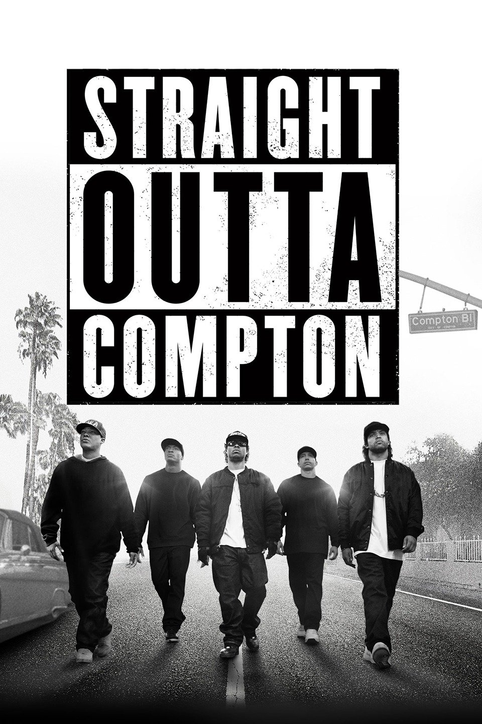
The movie
The movie 'Straight Outta Compton' came out on August 14, 2015. This movie accurately dictates the transformation of the group over many years. Even though some scenes are changed for plot in the movie, the film did a great job of telling their story. The film made $200 million on a $50 million budget. The movie also shows the impact the album had on many generations and decades. The group faced many problems on their way to stardom and the film shows all the problems and how they formed. The movie came out with a soundtrack that had music from N.W.A. and topped charts. Dr. Dre was inspired to come out with an album that was no. 2 on Billboard's top 200 list a week before the movie came out. 'Straight Outta Compton' was chosen by National Board of Review as one of the top ten films of 2015 and was nominated for the Academy Award for Best Original Screenplay.

Slide 10
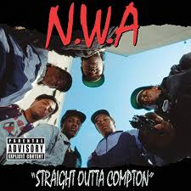
Conclusion
In conclusion, 'Straight Outta Compton' was a historic album that affected 4 decades and counting. The group N.W.A. are known by many people for being an 'OG' in gangsta rap. The group isn't only known for Hip-Hop classics but making fashion statements as well. They inspired many artists and many artists look up to them. I watched the movie before listening to the album but I found both very interesting.
https://www.youtube.com/playlist?list=PL4EDKDaqb5Fan6GQEL7mw5z1PMUS_6htD

