Slide 1
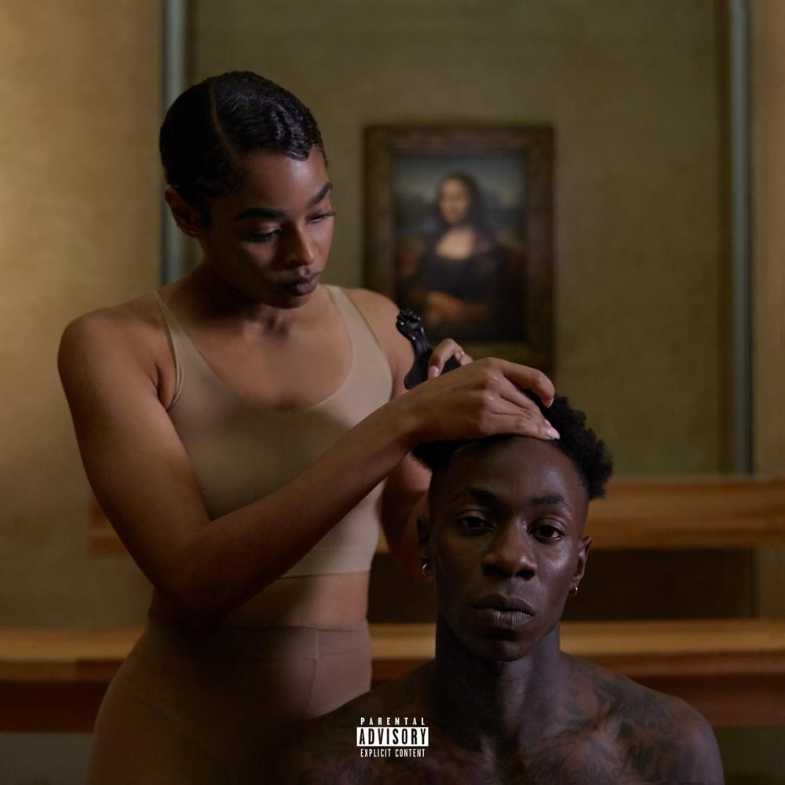
Everything is Love
A Connection to the Decades

Slide 2
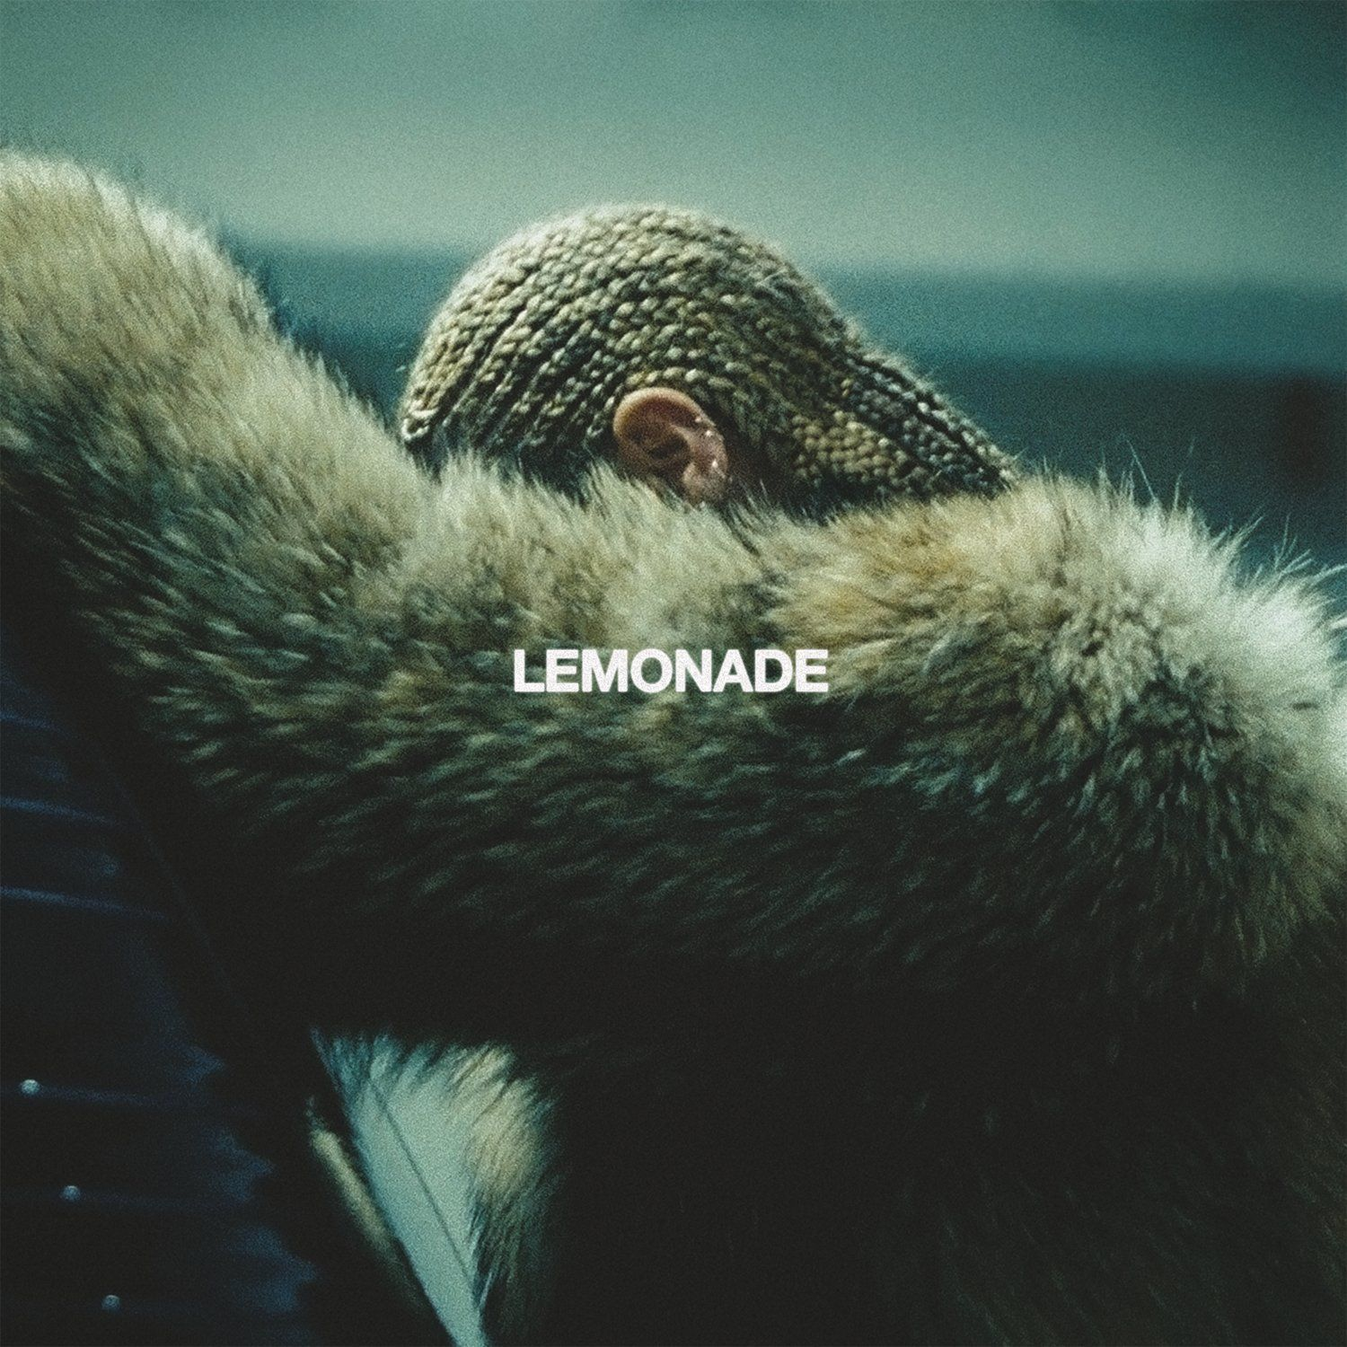
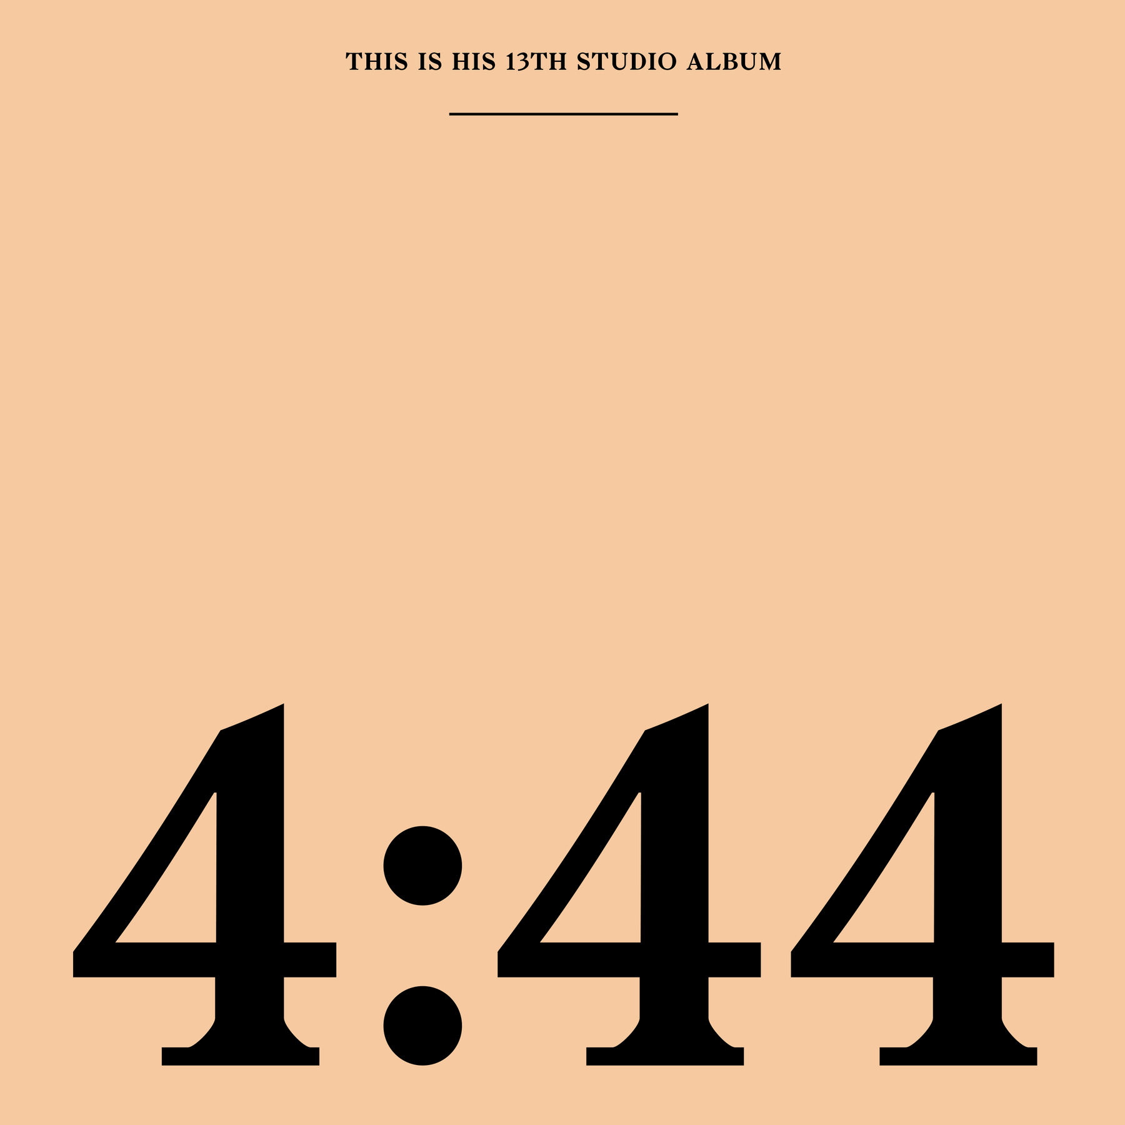
BackGround
Society’s emotional state in the mid-2010s ranged from anxiety to anger due to the divisiness in media and leadership. This divisiness can be examined in part by looking at the state of music at that time, specifically, Hip Hop’s leading example of marriage and family, The Carters. In 2016, the bombshell release that is Lemonade had woman around the world speaking out against the wrongdoings of their own significant others. Then 2017 came and 4:44 had many men looking back at their past, examining their present and planning for the future. You can feel the tension in the air from avid music listeners wondering if this might be the end of a legacy. Fast forward to the summer of 2018 and in the midst of Kanye’s 5 album rollout, The Carters return to profess their love for each other despite the public and private conflicts between them and once again capture the attention of the world.

Slide 3
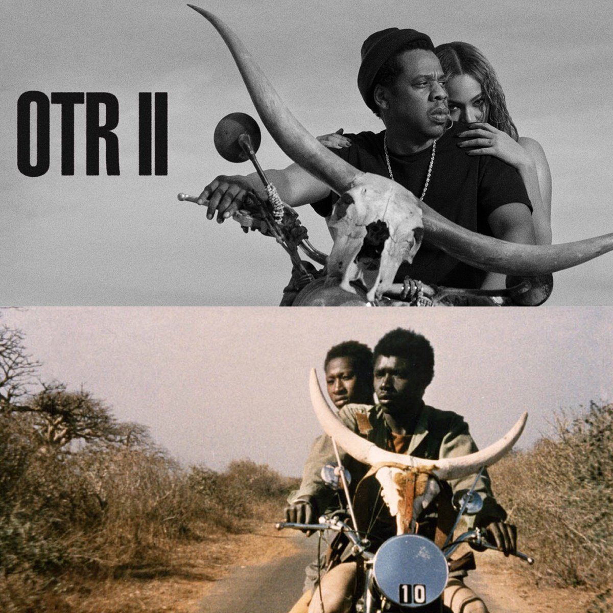
Running, Running
An assessment of The Carters’ Everything is Love, in connection to the decades, cannot begin without first acknowledging the entire album rollout as an integral part of the album experience. That album rollout begins with the announcement of their worldwide On The Run 2 Stadium Tour. Fans were treated to Hov & Bey together again riding an empty road on a motorcycle that is clearly in reference to the 70s Senegalese film, Touki Bouki. In Touki Bouki, we followed the story of two lovers who devise a plan to steal money in order to visit their dream city, Paris. Paris is very important in the world of Everything is Love because of the lead single, Apeshit.

Slide 4
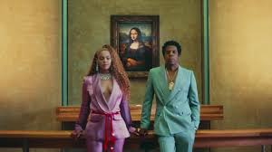
ApeShit
Everything is Love’s lead single, Apeshit, and the coinciding video is beautiful display of black bodies in historically white spaces. Even the name, Apeshit, seems to address how black people across the world have been viewed as ape-like or barbaric and this song is a reclamation of that ape-like mindset but it’s also an invitation to The Carters’ audience to go bananas. In the video, we see the Carters use their money and prowess to buy out one of the most sacred places in the art community for a music video. The Louvre becomes not only a backdrop but a character in the video connecting what many consider to be the modern day version of black royalty in America directly to the most famous artworks of the 14th and 15th century. But we not gonna get into how Everything is Love many references connect to different centuries, let’s stick to the decades.

Slide 5
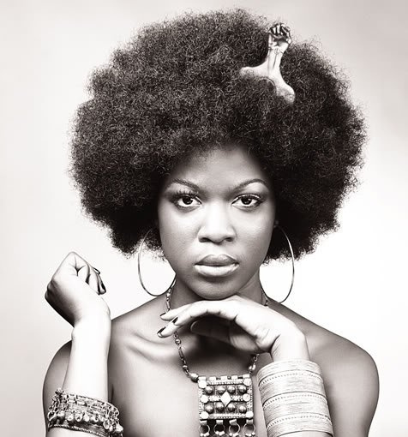
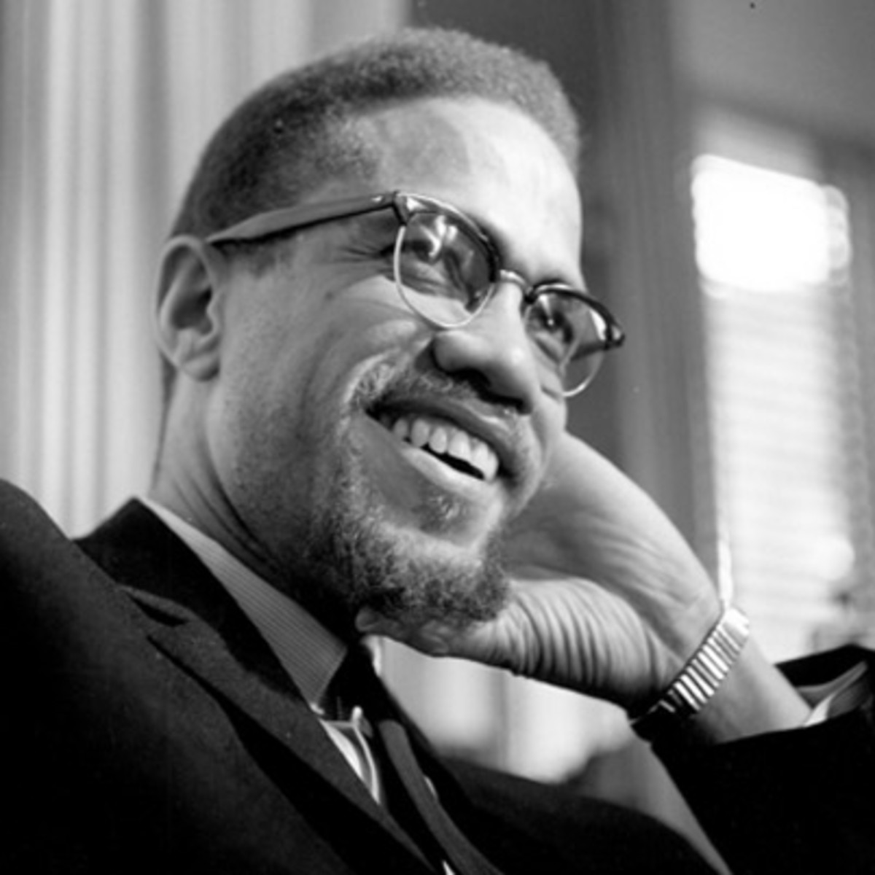
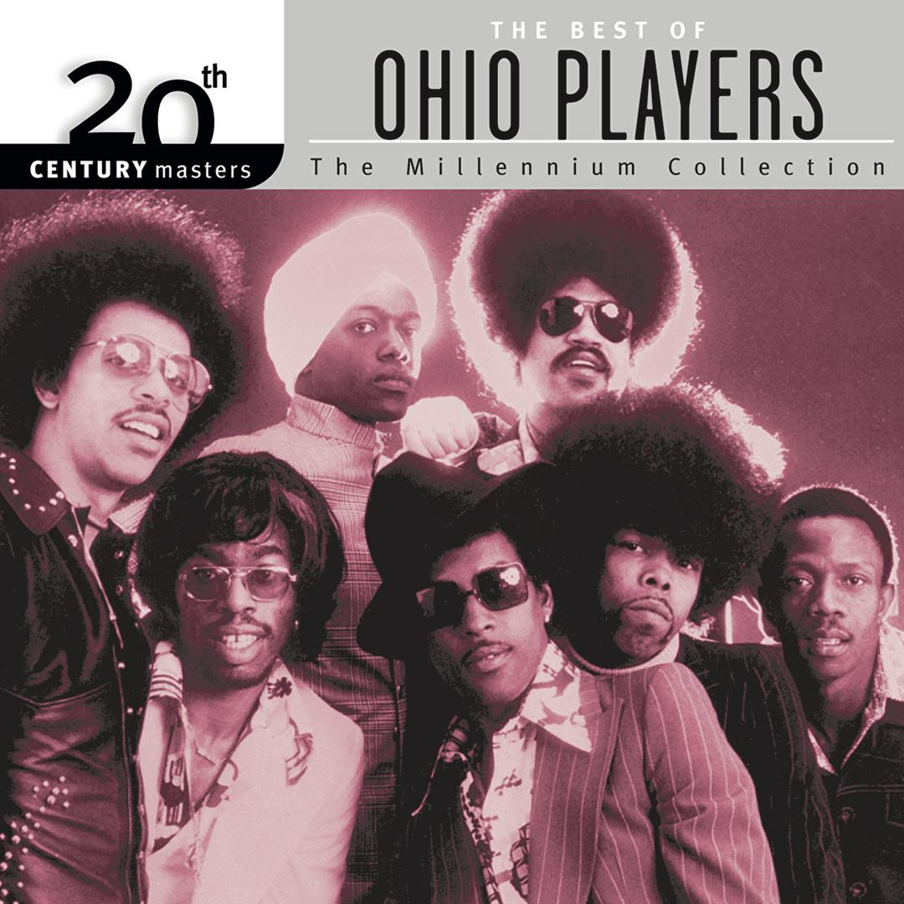
The 60s
By examining the cover art for Everything is Love, we immediately see the connection to the 60s in the black fist afro pick combed into the hair of the young black man. The black fist afro pick is especially iconic for its connection to the Black Panther movement. When that fist was in your hair, you were telling the world that you were part of the movement to heal and address the African diaspora. This connection to the past political movement of the Black Panthers is especially important because in this image the Mona Lisa is blurred out as to reject the European standards of beauty for something representative of black people. The connection this album has to the 60s is further reinforced by lyrics such as, “I’m good on any Malcolm X Boulevard” and “Ran through Liverpool like a f***** Beatle.” Analogous to the Blank Panther movement the samples used in this project such as, Still D.R.E. which itself samples the 70s hit Funky Worm by the Ohio Players and Black Effect’s leading sample Broken Strings by Flower Travellin’ Band, bleeds the rhythm of this project into the early 70s.

Slide 6
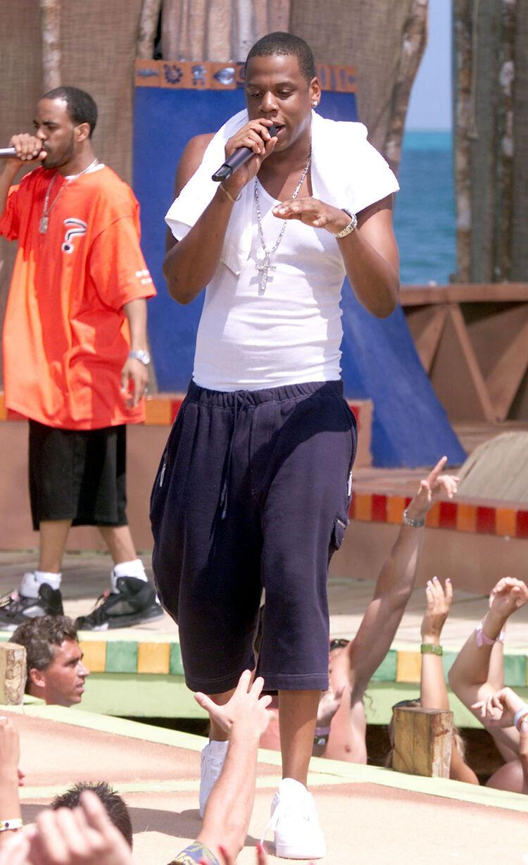
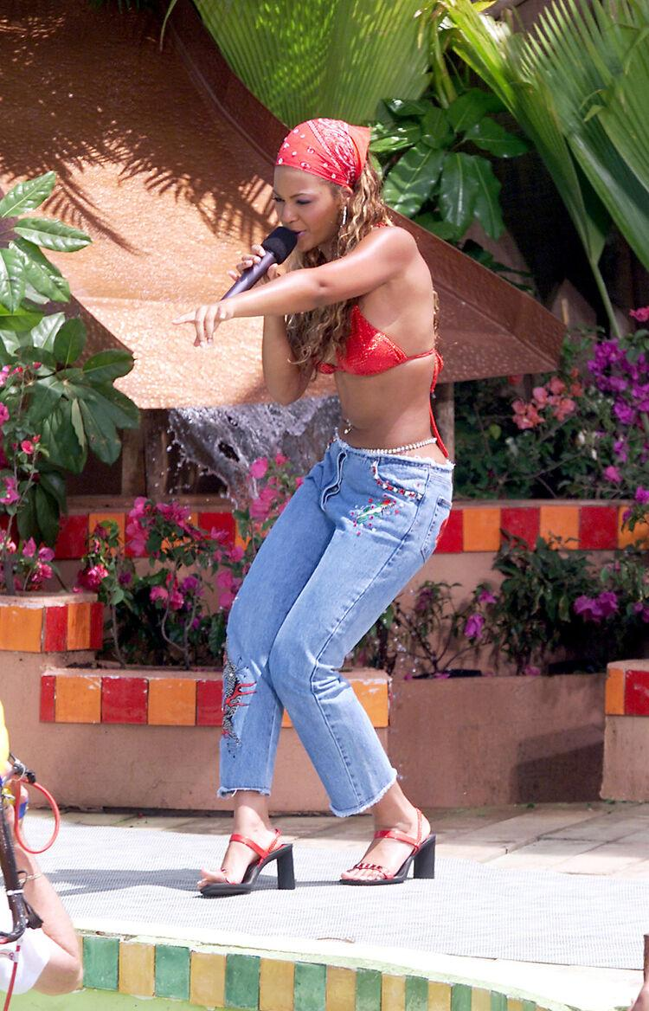
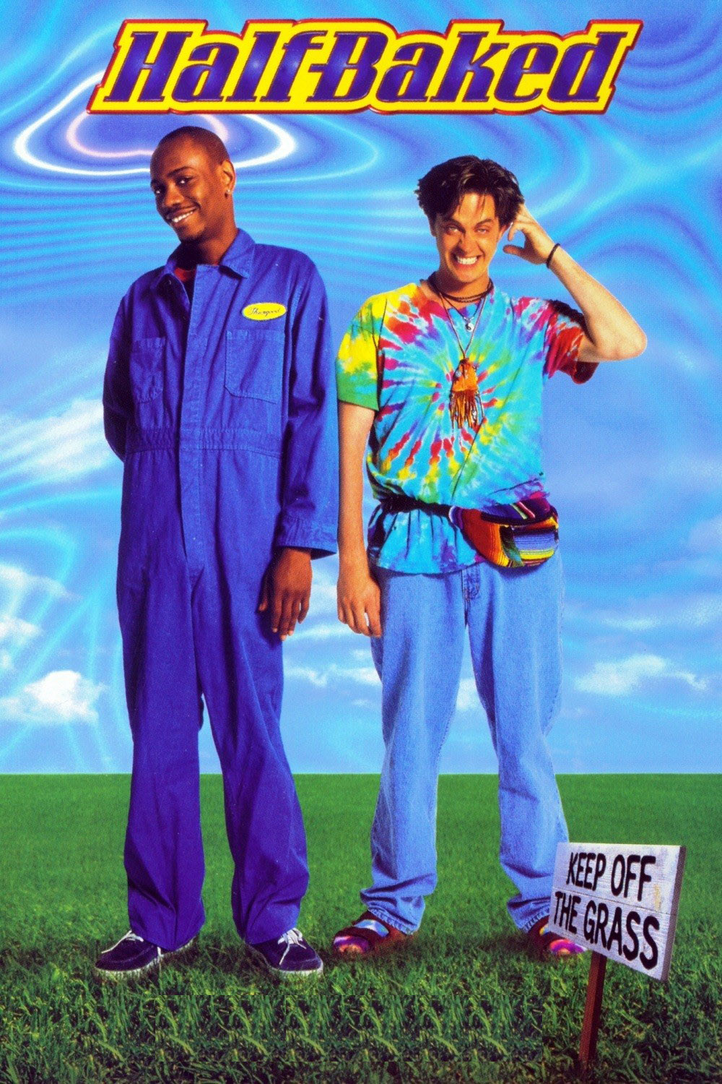
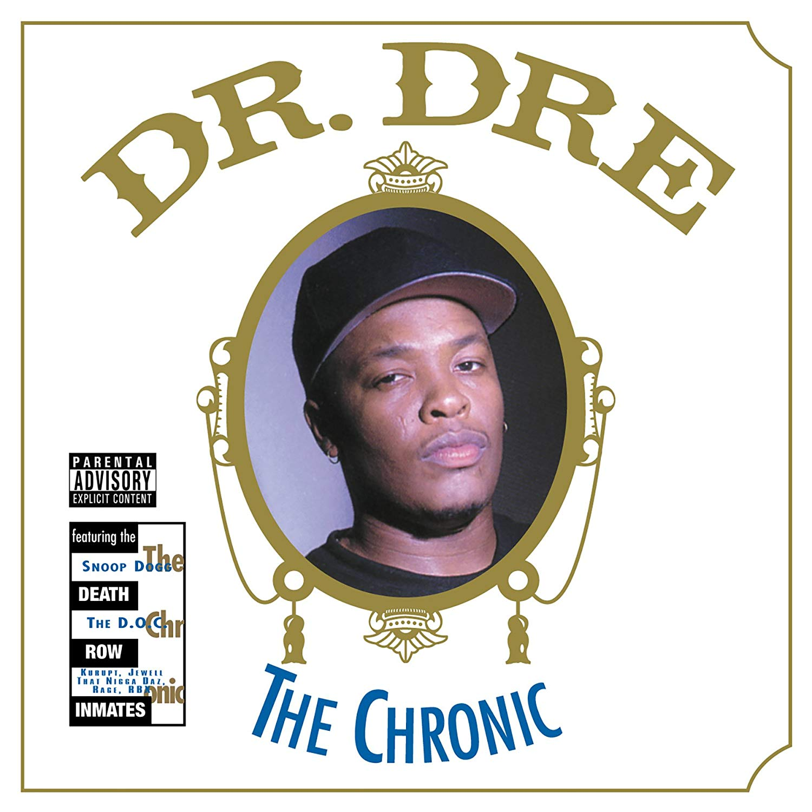
The 90s
The style and sound of the 90s permeate clearly in Everything is Love. Cadences that clearly mimic popular songs of the era decorate the vibe of the album. Lines like “Shutdown Colette” and “Ain’t shit change the streets is still watching” paint vivid imagery that the 90s are still on the mind of JAY-Z and Beyoncé. Why wouldn’t it be, that’s the time when they met which is referenced in “We played it cool at the pool of Cancun, VMA” The 90s is also relevant in cadences copied from the aforementioned, Still D.R.E. There’s even a nod to the popular 90s movie, Half-Baked when Beyoncé disses streaming company, Spotify. Everything is Love also bleeds into the early 00s by referencing songs like Love of my Life and the Light. The early 00s is also revisited by a new collaboration between Jay and Pharrell. (Love of my Life and the Light also contains samples from the early 70s).

Slide 7
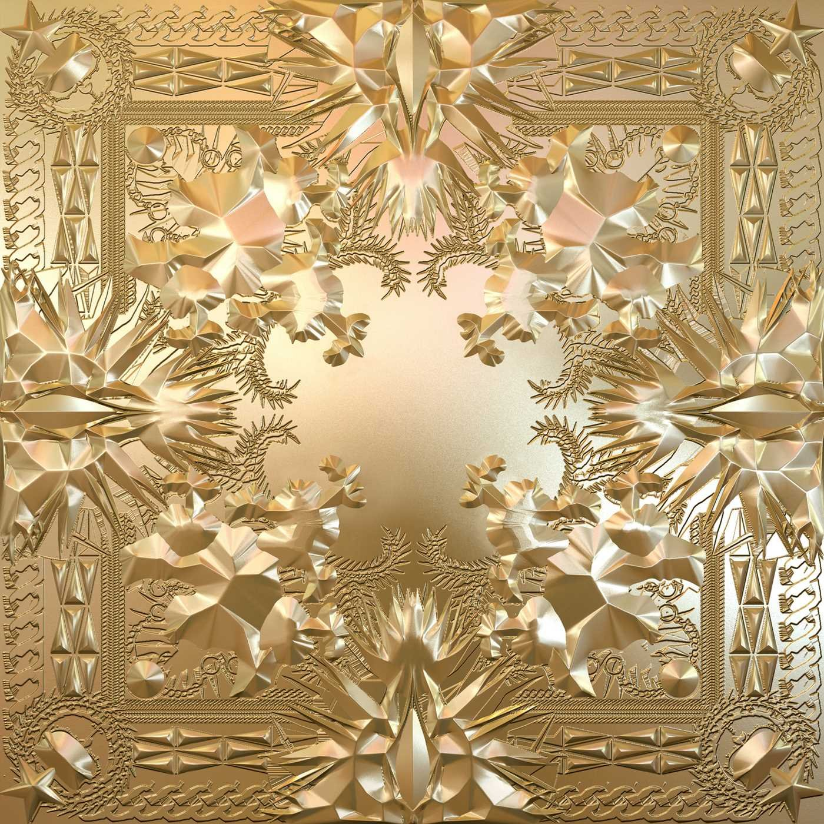
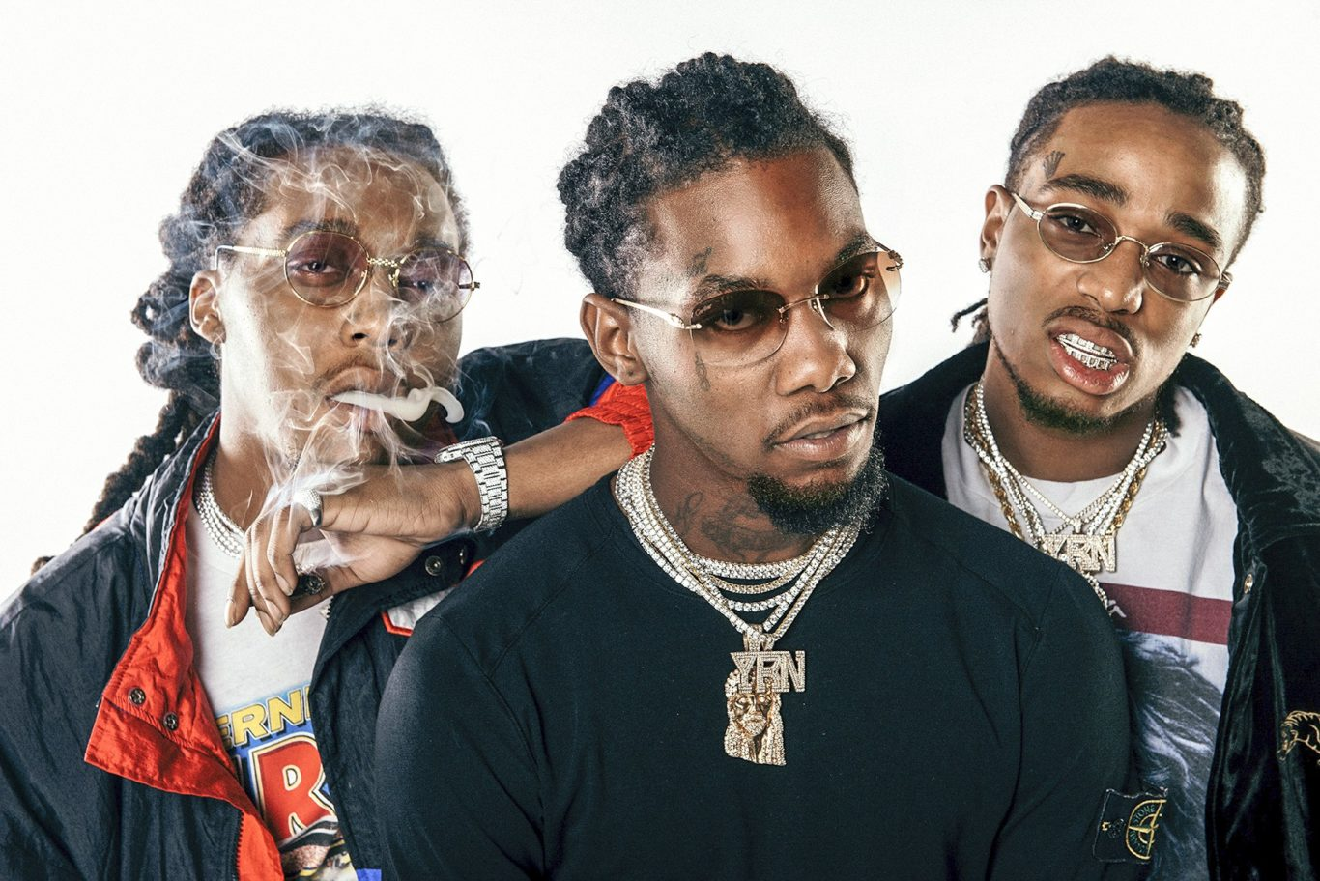
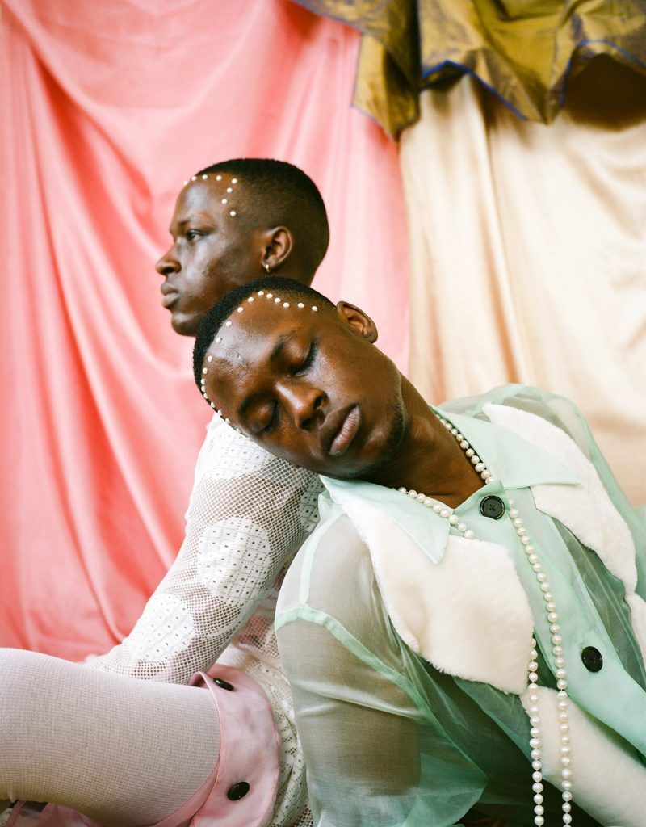
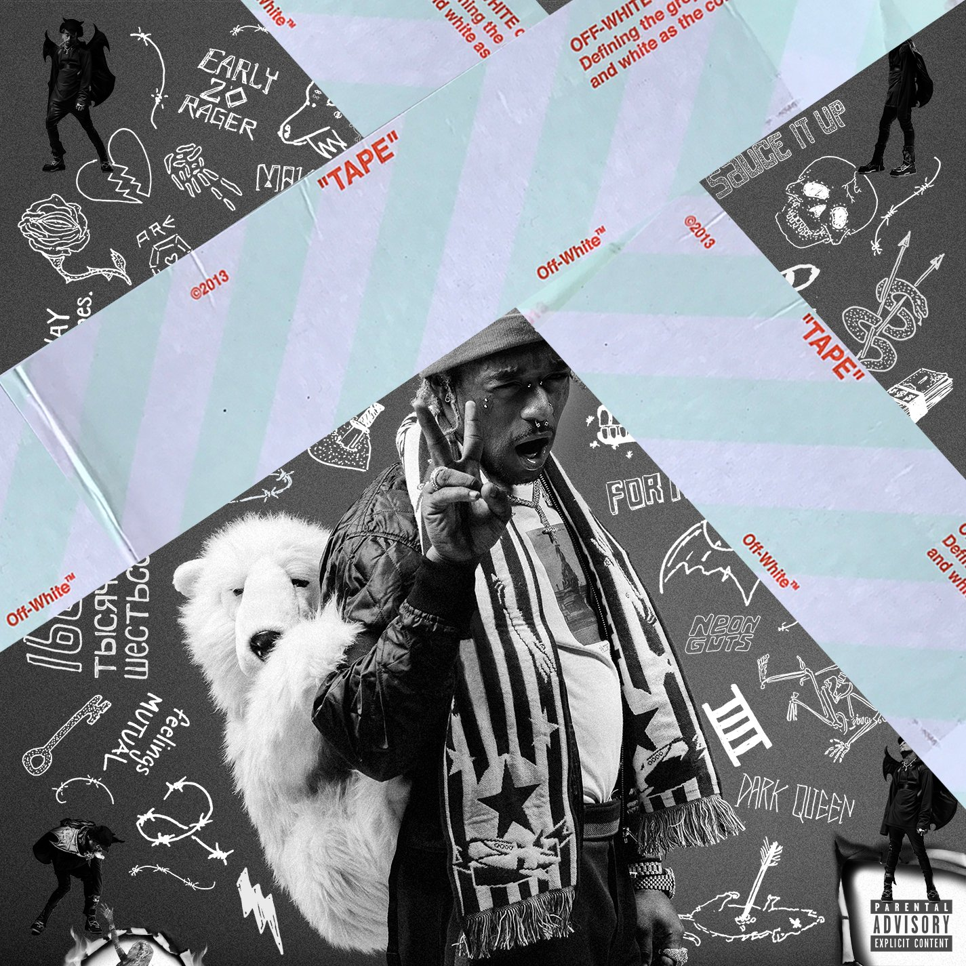
The 10s and Beyond
JAY-Z and Beyoncé’s ability to stay relevant in music has been historically one of their strongest characteristics and that talent does not waver in the project. What’s also interesting is that this album looks forward into the future of their marriage and legacy, many times referencing their children and even letting young Blue Ivy get behind the mic for a quick shoutout to her siblings. The Migos ad-libs on Apeshit, the trap hi-hats and 808s on Friends, the Instagram rollout and the stylistic imagery that samples Tyler Mitchell’s work is what makes this project feel current. There’s also commentary on Ye and Jay’s earlier collaboration with a line that states, “Hova, Beyzus, watch the throne”. There’s lines that mention Meek Mills wrongful imprisonment and there also the bounce on Nice that oddly resembles Lil Uzi’s Neon Guts.

Slide 8




COnclusion
Special ThX
Many other decades are referenced in Everything is Love through dialogue that remind us of Sarah Bartman’s hips and how Europeans paraded her as a freak attraction, JAY’s love for purple and how that is symbolic in his efforts to bring red and blue gangs together, or the constant reminder of their taste when mentioning Phillipe Patek. Affluence and influence aside, The Carters remind us that love is the key to all. Love for oneself, love for your spouse and love for your community are integral in healing the divide. The album Everything is Love masterfully executes this message by bouncing back and forth through decades reminding all listeners why we, as black people deserve to be loved.
-Garrison Johanson

