Slide 1
Transforming Writing Pedagogy With a Focus on Reading
Alice Horning, Oakland University
Cynthia Haller, York College, CUNY
Ellen Carillo, University of Connecticut

Slide 2
Goals for this workshop:
Understand students’ reading situation from recent studies
Experience the psycholinguistic character of reading
Explore ways to integrate rhetorical reading in writing classes
Develop a mindful framework for reading with writing

Slide 3
A riddle…
What does reading have to do with elephants?

Slide 4
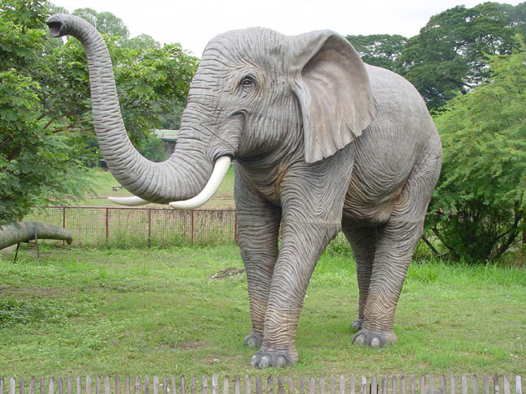

Slide 5
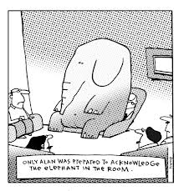

Slide 6
Reading is the elephant: Quantitative evidence
“Don’t, Won’t, CAN’T”-TOO big to ignore
ACT 2006, 2017 results—review test!
Citation Project, 2012
Info literacy—50% pass rate
NAEP– 37% proficient in 2015/63% basic or below basic
PISA-international 2012 8% at top reading proficiency

Slide 7
Citation Project results
2000 references from student writing.
only 6% use real summary.
46% cite from the first page of a source.
70% from first 2 pages.
majority of sources cited only once.

Slide 8

Thirty-seven percent of twelfth-grade students performed at or above the Proficient level in 2015 on the reading portion of the National Assessment of Educational Progress (NAEP).

Slide 9
Qualitative studies
Head=interviews with students (IL study at U of Washington
Harris=students in the library (I Found It on the Internet)
Stanford study of middle, high school and college students=“appalling”

Slide 10
STANFORD HISTORY EDUCATION GROUP STUDY (2016)
College
1) Article Evaluation:
In an open web search, students decide if a website can be trusted.
2) Research a Claim:
Students search online to verify a claim about a controversial topic.
3) Website Reliability:
Students determine whether a partisan site is trustworthy.
4) Social Media Video:
Students watch an online video and identify its strengths and weaknesses.
5) Claims on Social Media:
Students read a tweet and explain why it might or might
not be a useful source of information.

Slide 11
Implications
All show the same thing: don’t, won’t, can’t.
The size and nature of the problem should be clear.
We are all in this together and must work on students’ reading to meet our goals.

Slide 12
Discussion at tables
How do you see this playing out in your own classes or in your program?
Strategies: What opportunities are there for you to work on reading in your program or on your campus
?? Common book? Center for Teaching? Special programs?

Slide 13
Understanding the psycholinguistic features of reading
Reading is fast
Reading is focused on meaning
Reading is only incidentally visual

Slide 14
Observation exercise
Get a partner/observer & reader
Get out your book and read
Quiz on content follows, so pay attention to what you are reading!
Round 2: switch roles

Slide 16
The Boat in the Basement
A man was building a boat in his
basement. When he was done,
he discovered that the
the boot was too wide to go
though the door, so he had to
take the boat a part to get it out.
He should of planned ahead.

Slide 18
The Telephone Pole by Charles Baxter
Outside a man's window stood a
a telephone poll, in which birds
had dug seveeral holes. Because
the brids had caused all this
trouble, he decided that that the
telephone poll had to be cut down.
The man called telephone company,
which sent a truck out.

Slide 20
“What is it?”
"A krait," he said.
"A krait! Oh, my God! Where'd it bite you? How long ago?"...
"I haven't been bitten," he whispered. "Not yet. It's on my
stomach. Lying there asleep."...
"...Then out of the corner of my eye I saw this little krait sliding
over my pyjamas. Small, about ten inches. ..."
As a matter of fact it wasn't a surprising thing for a krait to do.
They hang around people's houses and they go for the warm
places. ... The bite is quite deadly except sometimes when you
catch it at once and they kill a fair number of people each year in
Bengal...I... fetched a small sharp knife from the kitchen. ...I was going to be ready to cut the bitten place and try to suck the venom out. ...
5 pages later
"It is not safe," he continued, "because a snake is cold-blooded
and anesthetic does not work so well or so quick with such
animals..."

Slide 21
Draw a picture
It must have been around midnight when I drove home, and as I approached the gates of the bungalow, I switched off the headlamps of the car so the beams would not enter the side window and wake Harry Pope.

Slide 22
With hocked gems financing him, our hero bravely defied all scornful laughter that tried to prevent his scheme. Your eyes deceive he had said. An egg, not a table, correctly typifies this unexplored planet. Now three sturdy sisters sought proof, forging along sometimes through calm vastness yet more often over turbulent peaks and valleys days became weeks as many doubters spread fearful rumors about the edge. At last from nowhere welcome winged creatures appeared signifying momentous success.

Slide 23
First Voyage of Christopher Columbus
With hocked gems financing him, our hero bravely defied all scornful laughter that tried to prevent his scheme. Your eyes deceive he had said. An egg, not a table, correctly typifies this unexplored planet. Now three sturdy sisters sought proof, forging along sometimes through calm vastness yet more often over turbulent peaks and valleys days became weeks as many doubters spread fearful rumors about the edge. At last from nowhere welcome winged creatures appeared signifying momentous success.

Slide 24
The Marlup
A marlup was poving his kump. Parmily a narg horped some whev in his kump. “Why did vump horp whev in my frinkle kump?” the marlup jufd the narg.“Er’m muvvily trungy,” the narg grupped. “Er heshed vump horped whev in your kump. Do vump pove your kump frinkle?” “Yes!”
1. What did the narg horp in the marlup’s kump?
2. What did the marlup juf the narg?
3. Was the narg trungy ?
4. How does the marlup pove his kump?

Slide 25
The nature of reading
READING is
  FAST
  Focused on MEANING
  Only incidentally visual
You now know about students’ reading difficulties and something about the nature of reading as a process

Slide 26
A definition…
Academic critical literacy is best defined as the psycholinguistic processes of getting meaning from or putting meaning into print and/or sound, images, and movement, on a page or screen, used for the purposes of analysis, synthesis, evaluation and application; these processes develop through formal schooling and beyond it, at home and at work, in childhood and across the lifespan and are essential to human functioning in a democratic society. (Horning, 2012)

Slide 27
And a goal…
Academic critical literacy is a key goal
  For students’ success in college
  For participation in democracy
  For their future lives

Slide 28
Discussion at tables
How to begin to move toward this goal: Exercises to do in class—sample passage
Pairs or groups
  Analysis—25 word summary
  Synthesis—other sources, prior knowledge
  Evaluation—authority, accuracy, currency, relevancy, appropriateness, bias
  How could you use this in YOUR class?

Slide 29
Strategies for all classes
1-understanding reading
2-overt teaching of critical reading strategies
3-modeling by reading aloud
4-25 word summaries (see Bazerman)
5-evaluation heuristic

Slide 30


Slide 31
Summary:
Reading is THE elephant: too big to ignore!
  You understand the problem
  You know something more about reading
  You can state explicitly the goal you are trying to achieve: academic critical literacy
  You have strategies to achieve this goal
  Reading has a direct impact on teaching and learning writing, as you will see after lunch.
  We reconvene in 60 minutes!

Slide 32
Thanks for your attention!

Slide 33
Reading For Research
Cynthia R. Haller
York College, City University of New York
Conference on College Composition and Communication
Kansas City, Missouri
March 14, 2018
Notes:
This template can be used as a starter file for presenting training materials in a group setting.
Sections
Sections can help to organize your slides or facilitate collaboration between multiple authors. On the Home tab under Slides, click Section, and then click Add Section.
Notes
Use the Notes pane for delivery notes or to provide additional details for the audience. You can see these notes in Presenter View during your presentation.
Keep in mind the font size (important for accessibility, visibility, videotaping, and online production)
Coordinated colors
Pay particular attention to the graphs, charts, and text boxes.
Consider that attendees will print in black and white or grayscale. Run a test print to make sure your colors work when printed in pure black and white and grayscale.
Graphics, tables, and graphs
Keep it simple: If possible, use consistent, non-distracting styles and colors.
Label all graphs and tables.

Slide 34
Overview
Challenges of Reading for Research
Anchoring Reading for Research Pedagogy in the Information Literacy Framework
  Research as Inquiry
  The Nature of Authority
  Searching as Strategic Exploration
Notes:
Give a brief overview of the presentation. Describe the major focus of the presentation and why it is important.
Introduce each of the major topics.
To provide a road map for the audience, you can repeat this Overview slide throughout the presentation, highlighting the particular topic you will discuss next.

Slide 35
Challenges of Reading for Research
Text Selection
Text Interpretation
Reading Strategies

Slide 36
Text Selection Challenges
Course Texts: Teacher Selects
Research Texts: Students Select
Number of texts narrow and finite
Access: easy, supplied in either print or digital form
Length and genre winnowed by faculty sensitive to pacing
Reading level tailored by faculty to student reading levels
Number of texts effectively infinite
Access: difficult and uncertain, may be effectively impossible
Length and genre vary widely without regard to student pacing
Reading level widely variant

Slide 37
Text Interpretation Challenges
Research Texts:
Little Interpretive Support
Course Texts:
Much Interpretive Support
Relevance explained by professor
Evaluation of quality not required
Rhetorical/MetaContextual Awareness: Professor builds in class
Intertextual Connections often supplied in class
Relevance determined by student
Evaluation of quality required
Rhetorical/Metacontextual Awareness: Students must ascertain
Intertextual Connections Students must ascertain connections

Slide 38
Reading Strategy Challenges
Course Texts:
“Strong Reading” Required
Research Texts:
Multiple Strategies Required
Close Reading of Full Text generally expected
Required literacies
  Alphanumeric texts
  Visual Literacy
  Auditory Literacy
Scanning and Skimming required as much or more than Close Reading
Required literacies
  Alphanumeric texts
  Visual Literacy
  Auditory Literacy
  SEARCH LITERACY

Slide 39
Small wonder that students…
Describe the research process as overwhelming and frustrating(Head)
Frequently procrastinate in beginning research (Head)
Adopt coping strategies rather than research strategies (Leckie)
Are driven by finding the required number of sources rather than the relevance and quality of sources to their inquiry (Leckie)
Content themselves with isolated sources rather than discovering a network of connected sources that will help them develop a mental model of their topic/question (Haller and Laskin)
Most often read and incorporate only material in the first few pages of sources (Howard, Serviss, and Rodrigue)

Slide 40
What’s a Composition Professor to Do?
Anchor Reading for Research Pedagogy in Information Literacy Threshold Concepts
Approach Research as Inquiry
Foster Rhetorical Reading/Metacontextual Awareness (Horner)
Foster Search Literacy
Notes:
Handout: Suggested scaffolding for research writing.

Slide 41
Anchor Reading for Research Pedagogy in Information Literacy Threshold Concepts
Information Literacy Framework: Approved by the ACRL Board, January 11, 2016
Revises and updates Information Literacy Competency Standards for Higher Education adopted by Association of College and Research Libraries (ACRL) in 2000.
Organized into six “frames,” each consisting of a threshold concept central to information literacy, a set of knowledge practices, and a set of dispositions
Available at http://www.ala.org/acrl/standards
Notes:
Handout: Information Literacy Framework excerpts

Slide 42
IL Threshold Concept:
Research as Inquiry
Research is iterative and depends upon asking increasingly complex or new questions whose answers in turn develop additional questions or lines of inquiry in any field.

Slide 43
“Research as Inquiry”
A Closer Look
Research as inquiry is the process of developing a dynamic mental model of a topic using reading and writing as ways of thinking
As a process, research as inquiry is ongoing. It never ends.
Notes:
Handout on scaffolded tasks

Slide 44
So What is a “Research Product”?
A representation of a mental model developed through research inquiry.
A research product is generated at a given point in time within a particular context for a specific audience and purpose.
Notes:
Handout on scaffolded tasks

Slide 45
IL Framework Threshold Concept: Authority Is Constructed and Contextual
Information resources reflect their creators’ expertise and credibility, and are evaluated based on the information need and the context in which the information will be used. Authority is constructed in that various communities may recognize different types of authority. It is contextual in that the information need may help to determine the level of authority required.

Slide 46
What Does the Nature of Authority Mean for Research Reading and Writing?
Students need to develop awareness of sources’ authors, purposes, and contexts of production
Students need to develop awareness of the authority, purpose, and context of production for their own research product.
Notes:
Teach them to think of research writing as repurposing source texts for a new context.

Slide 47
IL Threshold Concept:
Searching as Strategic Exploration
Searching for information is often nonlinear and iterative, requiring the evaluation of a range of information sources and the mental flexibility to pursue alternate avenues as new understanding develops.

Slide 48
Fostering Search Literacy
What does horse racing have to do with search literacy?
The interfaces of databases are “horse racing” texts and students need to be taught to read them.
Notes:
Handout and Discussion of Horse Racing chart
Reading electronic database results activity (Google pdf)

Slide 49
Scaffolding Reading and Searching Strategically
It’s not enough to scaffold research writing. We need to scaffold research reading, focusing on using multiple reading and searching strategies to support mental model development.
Notes:
Handout on scaffolded tasks

Slide 50
Making Reading Visible Within a Mindful Reading Framework
Ellen C. Carillo
Associate Professor of English and Writing Coordinator
University of Connecticut
ellen.carillo@uconn.edu

Slide 51
Students Are Not Reading Well!
How can we teach reading in first-year writing courses to facilitate transfer in order to prepare students to read in other courses and contexts?

Slide 52
Transfer of Learning: “Transfer of learning occurs when learning in one context or with one set of materials impacts on performance in another context or with other related materials.” (Perkins and Salomon)

Slide 53
We normally acknowledge, however grudgingly, that writing must be taught and continue to be taught from high school to college and perhaps beyond. We accept it, I believe, because we can see writing, and we know that much of the writing we see is not good enough. But we do not see reading. We see some writing about reading, to be sure, but we do not see reading. I am certain, though, that if we could see it, we would be appalled.
– Robert Scholes (emphasis added)

Slide 54
Annotation as a way to make reading visible and
●a bridge between reading and writing
●the initial and preliminary ways that student-readers participate in a scholarly conversation
●the basis for the more detailed and comprehensive contributions student-readers might be expected to make later on in writing

Slide 55
Some Reading Strategies I Teach
●Rhetorical Reading
●Says/Does Approach
●Believing/Doubting Game
●Reading Like a Writer (popularized by Bunn)
●Reading for Credibility

Slide 56
Transfer of Learning: “Transfer of learning occurs when learning in one context or with one set of materials impacts on performance in another context or with other related materials.” (Perkins and Salomon)
Bounded Frames connect the material only to the current course; do not encourage the transfer of learning.
Expansive Frames emphasize the potential for materials to be used in other contexts; encourage the transfer of learning.

Slide 57
The Mindful Reading Framework
•An expansive, metacognitive framework to promote the transfer of learning
•A framework in which to teach the range of reading strategies an instructor chooses
•A framework that encourages students to regularly reflect on the reading strategies they are using and on themselves as readers

Slide 58
From Farmer and Arrington’s (1993) “Apologies and Accommodations: Imitation and the Writing Process”
“Rumors of imitation’s death have been greatly exaggerated” (12).
They call for a dialogue about how “imitation might be seriously rethought” (27).

Slide 59
Sources that expose the use of models in the classroom:
Bartholomae and Matway, “The Pittsburgh Study of Writing.”
Across the Disciplines, 2010.
Bunn, “Motivation and Connection: Teaching Reading (and
Writing) in the Composition Classroom.” CCC, 2013.
Carillo, Securing a Place for Reading in Composition: The
Importance of Teaching for Transfer, 2015.
Jolliffe and Harl, “Studying the ‘Reading Transition’ from High
School to College: What Are Our Students Reading and Why?” College English, 2008.

Slide 60
Quintilian on Imitation
“First of all, then, imitation is not sufficient on its own. For one thing, only a lazy mind is content with what others have discovered” (10.2.4).
“And nothing does grow by imitation alone. But if we are not allowed to add to previous achievements, how can we hope for our ideal orator?” (10.2.8-9).
“[The student must] first understand what it is that he is going to imitate, and to know why it is good” (10. 2. 18).

Slide 61
The Washington Post uses annotation to provide “context and commentary” for readers. The New York Times and other outlets do the same.
New York Society Library held a 2015 exhibition “Readers Make their Mark.”
Annotated versions of the Constitution and the Declaration of Independence were released in 2009.
Websites including Book Traces and Annotated Books Online track readers’ commentary on books.
Kindle boasts “popular highlights” and “public notes” features.
Platforms like Genius, i.Annotate, and Diggo let students digitally annotate texts and share their annotations.

Slide 62
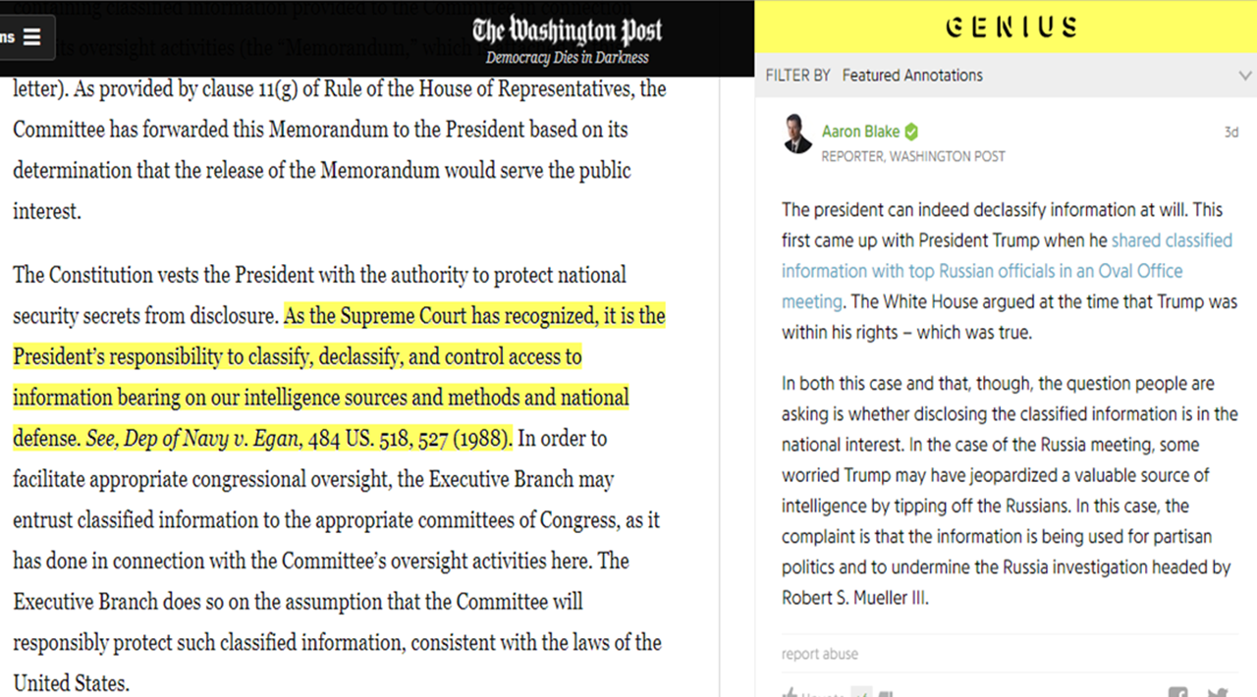

Slide 63
Exercise:
LEARNING ABOUT YOURSELF AS A READER
In the packet I am distributing are two individual readings (stapled together). Read them both and annotate them as you would under regular circumstances.

Slide 64
Using Goldschmidt’s Meta Reading Checklist, track your annotations
How many annotations fall into the 1st category, the 2nd, the 3rd, and the 4th?
What are you learning about yourself as a reader?

Slide 65
Some Questions
What struck you about your annotations?
How do your annotations on the two pieces compare?
Into which category do most of your annotations fall? Does this depend on the piece?
What did you learn about yourself as a reader?

Slide 66
RHETORICAL READING EXERCISE
Rhetorically (re)read the two pieces in your packet.
Pay attention to the rhetorical elements listed on the following slide.

Slide 67
READING RHETORICALLY
1. What is the author’s purpose?
2. Who is the intended audience?
3. What are the author’s claims?
4. What kinds of evidence are used?
Ethos: Appeals to credibility.
Pathos: Appeals to emotions.
Logos: Appeals to logic.

Slide 68
QUESTIONS
What did rhetorical reading allow you to understand in each piece?
What did rhetorical reading prohibit you from understanding in each piece?
What limits did you experience while reading in this way?

Slide 69
ADDITIONAL QUESTIONS
What could you do now having rhetorically read the two pieces?
What kind of assignment could you complete in light of your rhetorical reading? A summary? An analysis? Could you compose a similar piece that uses the same writerly techniques?

Slide 70
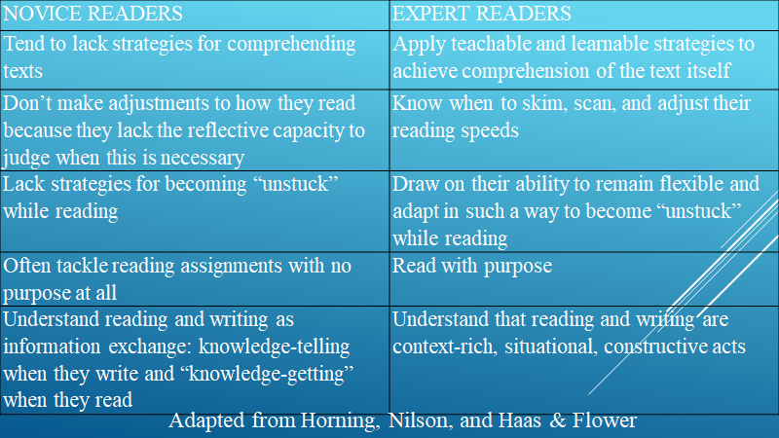

Slide 71
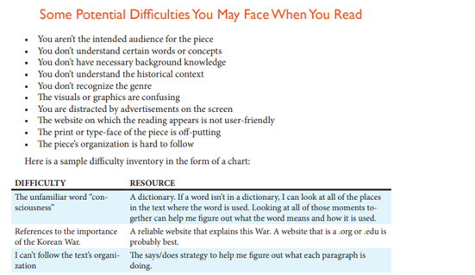

Slide 72
Thank you for listening and participating!
I hope to see you in person over the next few days!

